Slide 1
IPhone及IPad开发基础
岩延
yany@ucas.ac.cn 88256565

Slide 2
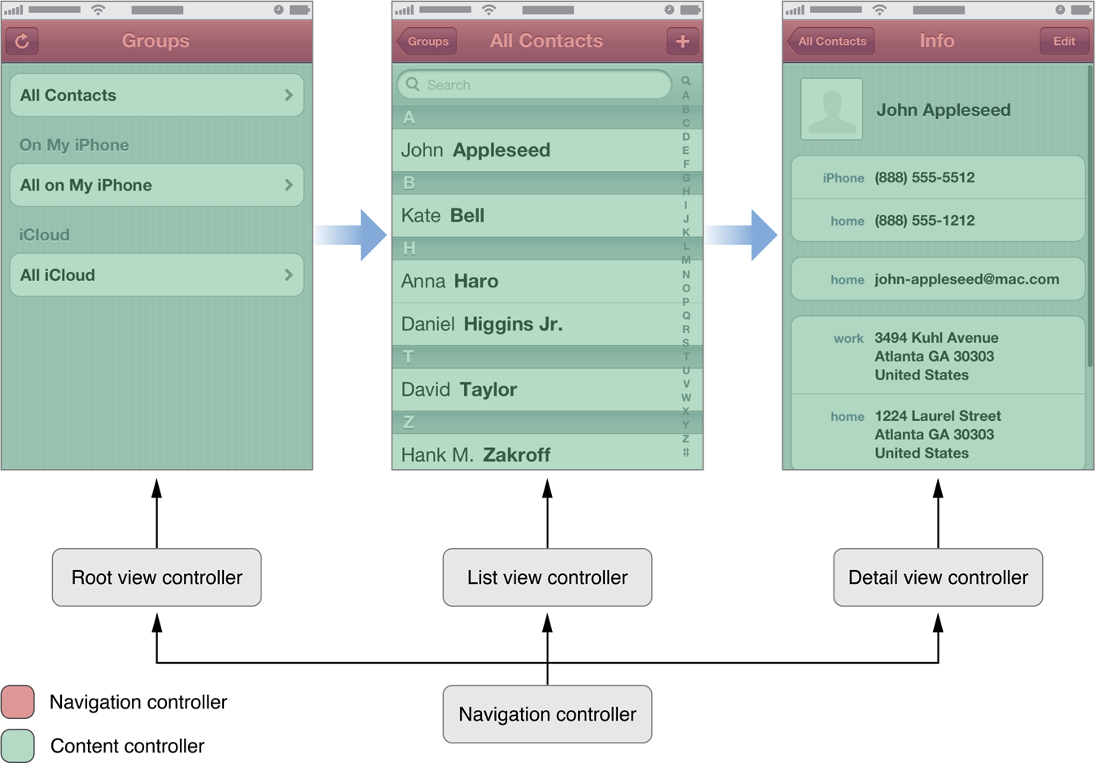
View Controller
View Controller
  View controllers are a vital link between an app’s data and its visual appearance

Slide 3
View Controller
View Controller
  总是UIViewController的Subclass
    管理一组Views
  Content View Controller负责显示内容
  Container View Controller管理其他content View Controller

Slide 4
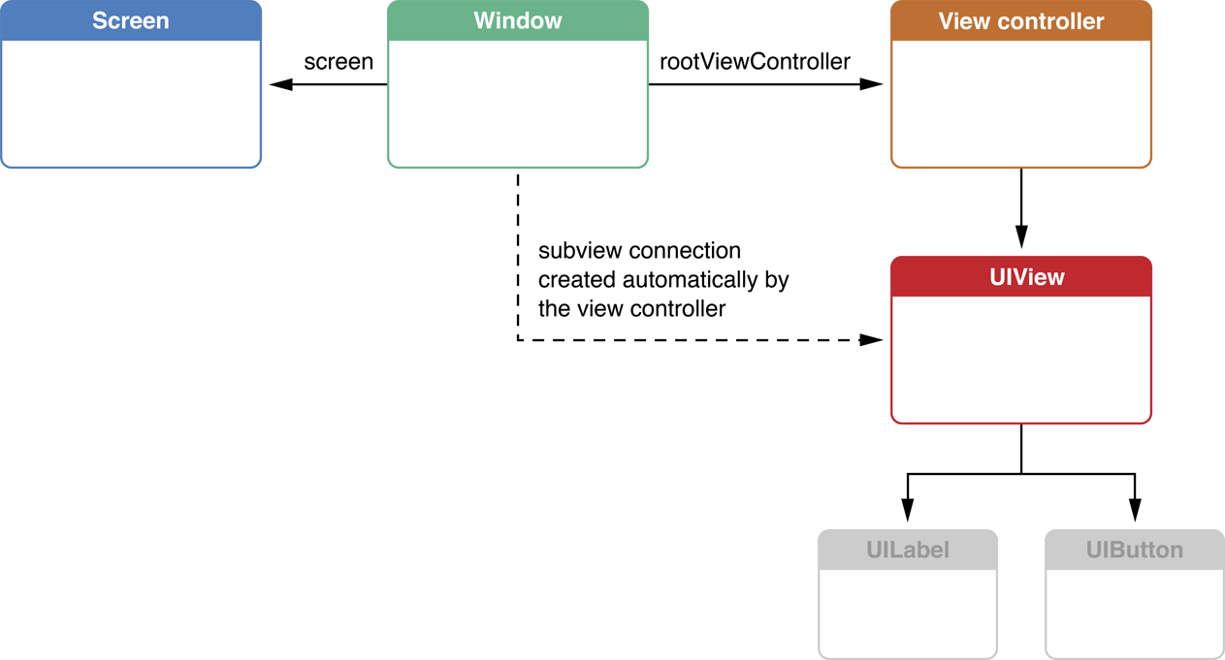
View Controller
View Controller管理一组Views
  Root View及View层次

Slide 5
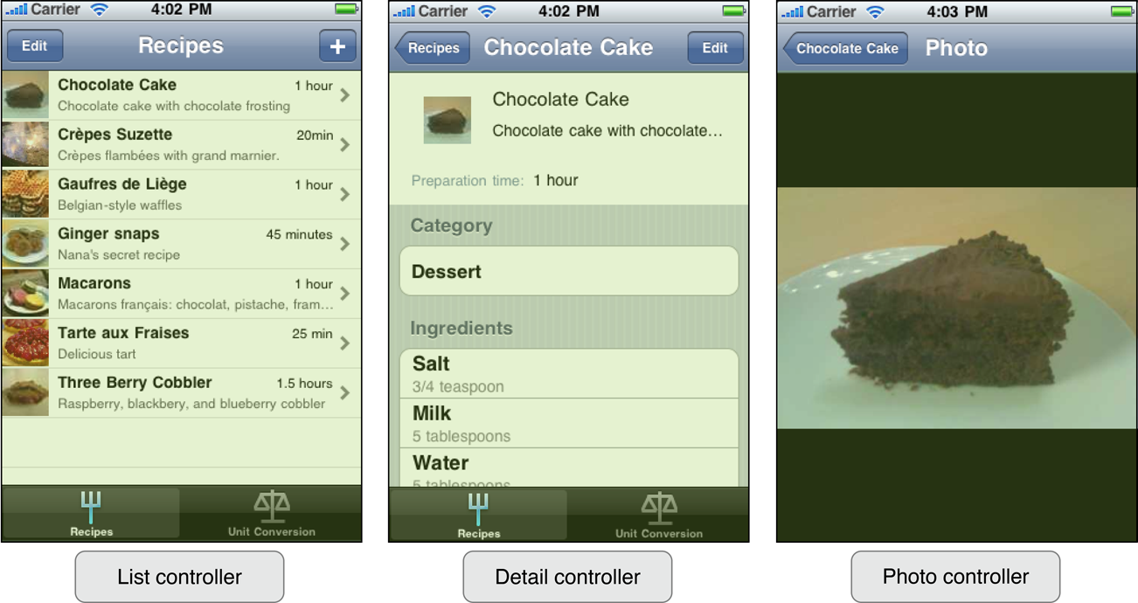
Multiple MVC
Multiple MVC

Slide 6
View Controller的分类
分为两大类
  content view controllers
  container view controllers
Content View Controller显示内容
  for example: table view controller
Container View Controller安排其他的View Controller的显示
  Controller’s controller
    Navigation Controller
    Tab Bar Controller
    Split View Controller

Slide 7
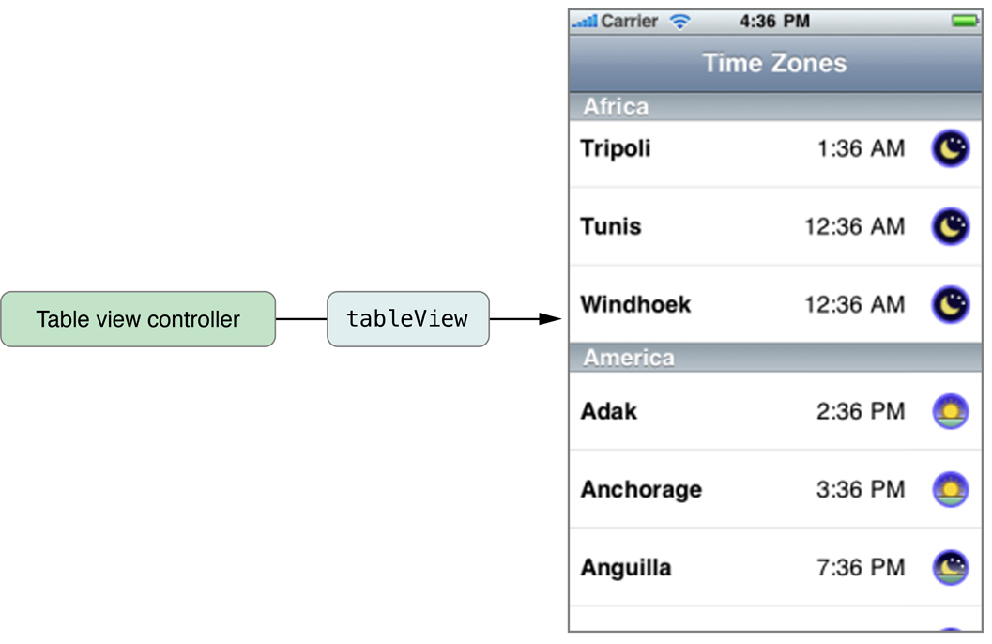
View Controller的分类
Table View Controller
  UITableViewController

Slide 8
Navigation Controllers
UINavigationController

Slide 9
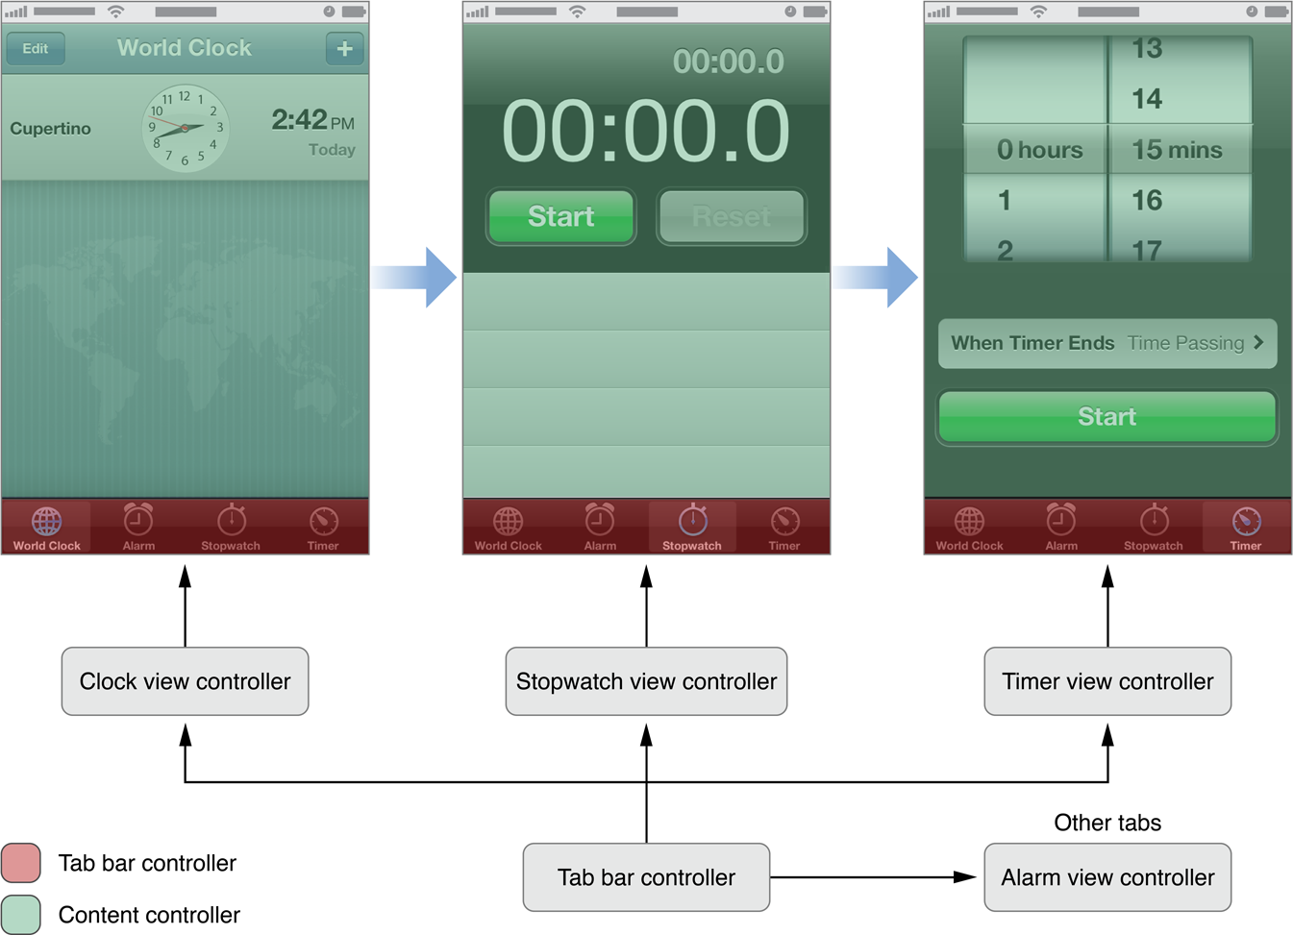
Tab Bar Controllers
UITabBarController

Slide 10
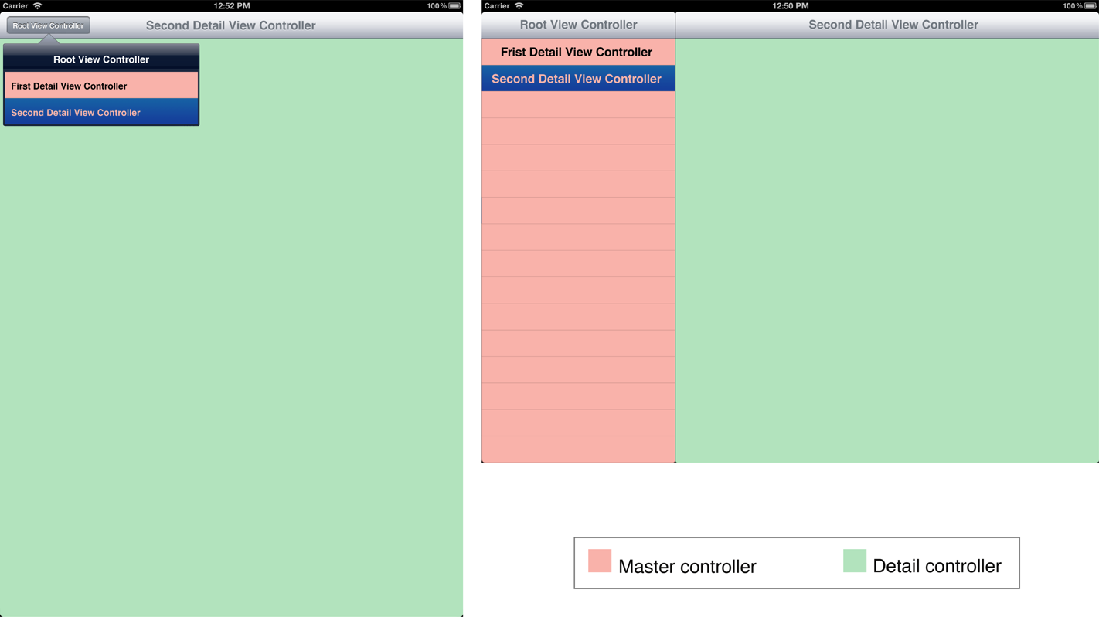
Split View Controllers
UISplitViewController

Slide 11
View Controller
如何取得子MVC？
      var viewControllers: [UIViewController]? { get set } // possibly an optional
如何取得container view controllers
  每个UIViewController都知道属于什么vc
      var tabBarController: UITabBarController? { get }
      var splitViewController: UISplitViewController? { get }
      var navigationController: UINavigationController? { get } !
      if let detailVC: UIViewController? = splitViewController?.viewControllers[1] { … }

Slide 12
Multiple MVC
一般来说一个app需要多个MVC.
添加新的MVC
  使用storyboard
  拖拽一个新的 “View Controller”.
  创建一个新的UIViewController 子类.
  在Attributes Inspector中为这个新的new Controller 设定这个子类.
如何显示新的MVC？
  UINavigationController
  UITabBarController
  其他机制(popover, modal, etc.).

Slide 13
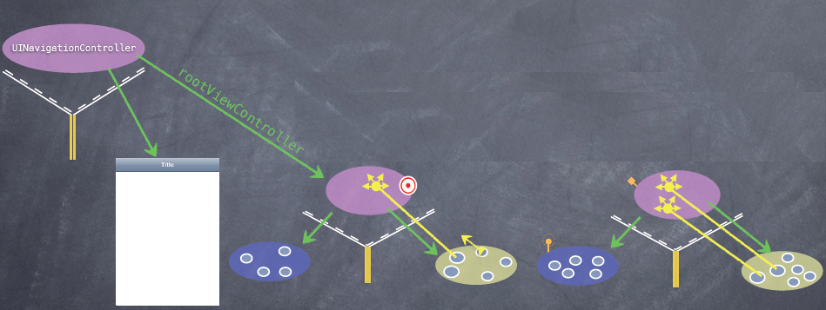
Multiple MVC

Slide 14
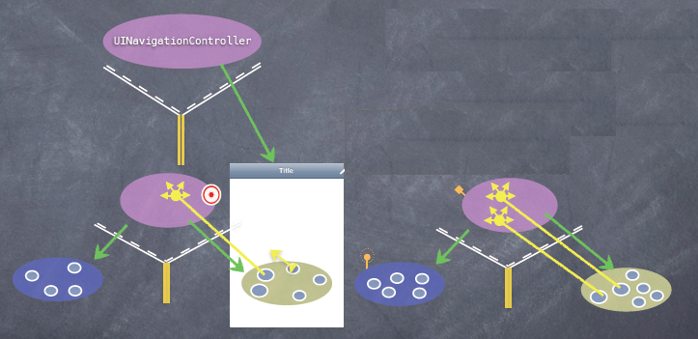
Multiple MVC

Slide 15
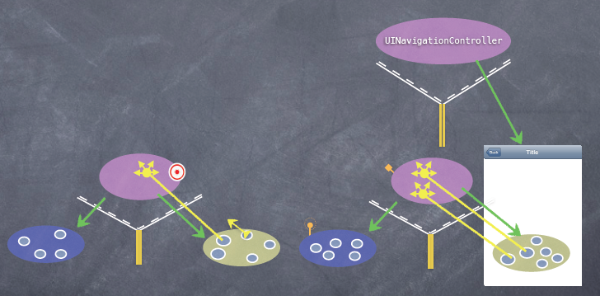
Multiple MVC

Slide 16
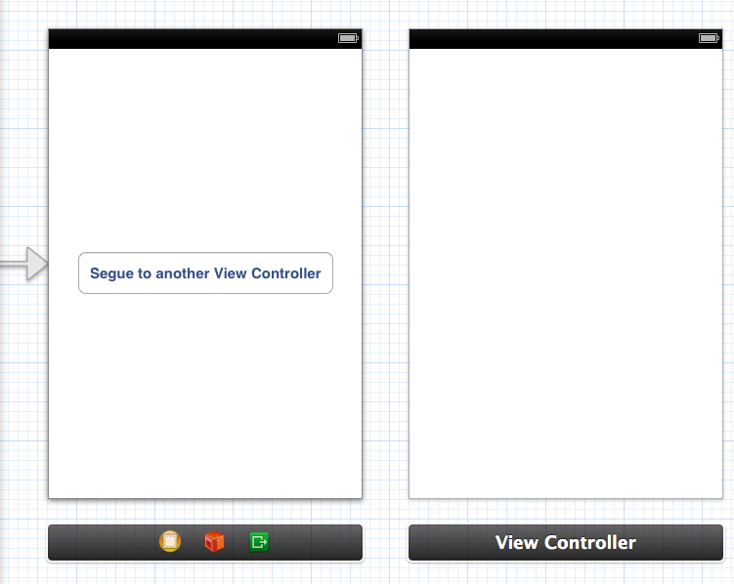
Segue

Slide 17
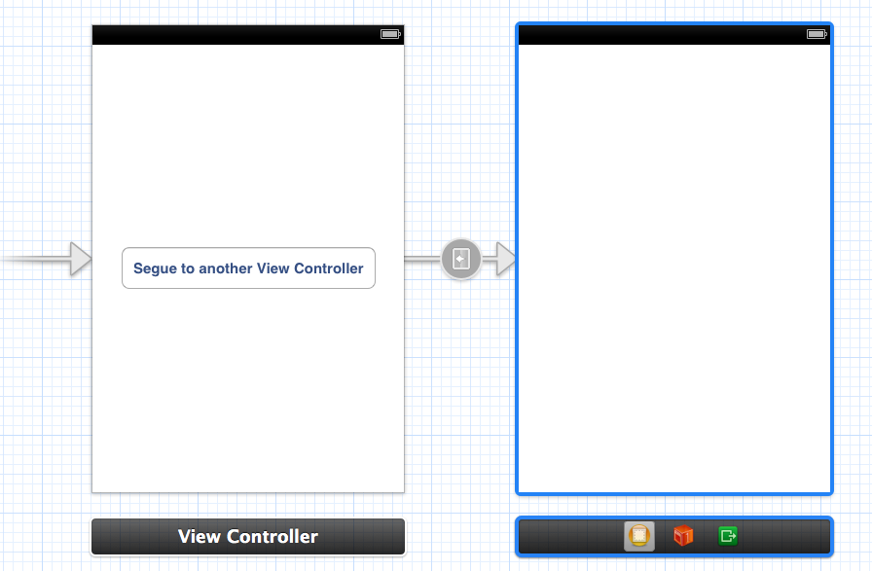
Segue

Slide 18
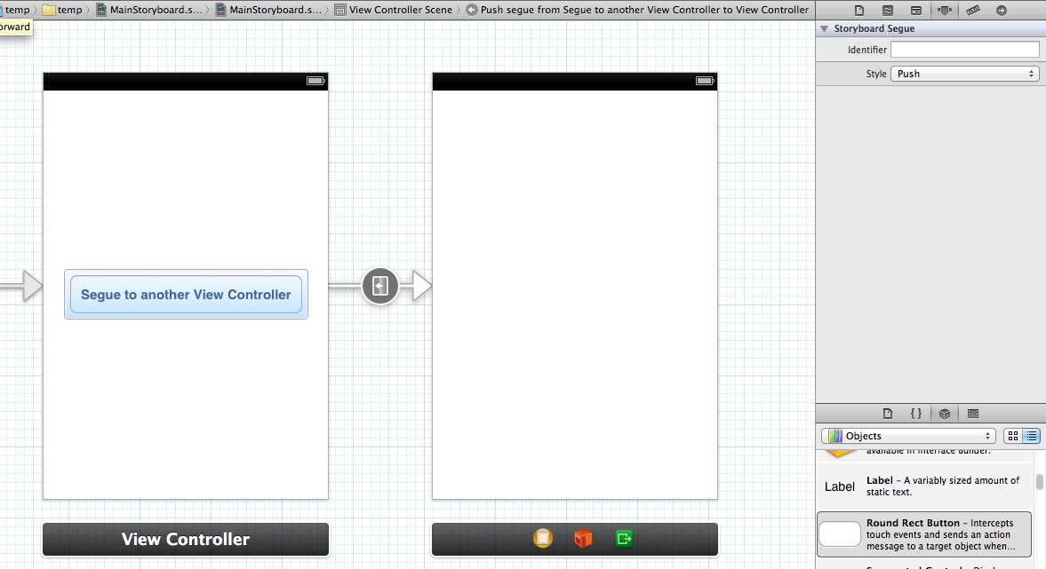
Segue
func prepareForSegue(segue: UIStoryboardSegue, sender: AnyObject?)
func performSegueWithIdentifier(identifier: String, sender: AnyObject?)

Slide 19
Segue类型
Segue类型
  Show
  Show Detail
  Modal
  Popover

Slide 20
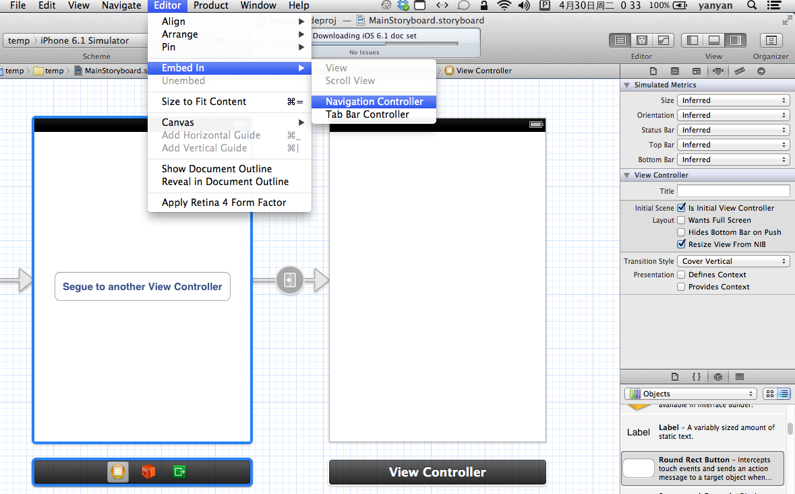
Segue

Slide 21
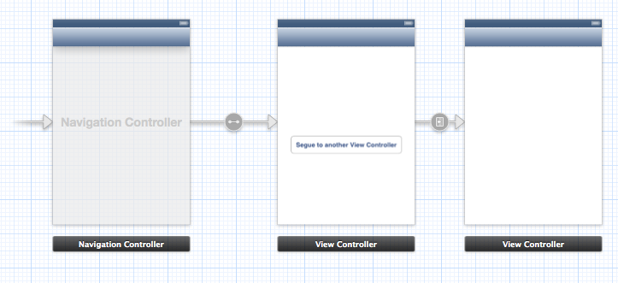
Segue

Slide 22
使用代码控制Segue
在UIViewController中调用下列代码
  func performSegue(WithIdentifier: String, sender : Any?)

Slide 23
使用代码控制Segue
Segue会给源view controller机会给新的view controller做好准备工作
  func prepare(for segue: UIStoryboardSegue, sender: Any?)
  func prepare(for segue: UIStoryboardSegue, sender: Any?) {
    if let identifier = segue.identifier {
    switch identifier {
    case “Show Graph”:
    if let vc = segue.destinationViewController as? MyController {
    vc.property1 = …
    vc.callMethodToSetItUp(…)
    }
    default: break
    }
    }
    }

Slide 24
View Controller Lifecycle
View Controller Lifecycle
  View Controller被创建、存活然后消亡的过程
  实际上是一组message
  一般需要重写这些消息去完成特定的工作
创建View Controller
  Segue
  Storyboard的instantiateViewControllerWithIdentifer
  一般不需要使用代码
创建后？
  Outlet setting.
  Appearing and disappearing.
  Geometry changes.
  Low-memory situations.
  At each stage, iOS invokes method(s) on the Controller ...

Slide 25
View Controller Lifecycle
viewDidLoad
  在实例化以及outlet连接完成以后，viewDidLoad被调用
    override func viewDidLoad() {
    super.viewDidLoad() // always let super have a chance in lifecycle methods
    // do some setup of my MVC
    } 注意，这里View的bounds还没有确定！
viewWillAppear
  在View出现在屏幕之前，系统调用viewWillAppear:
    func viewWillAppear(animated: Bool)
  此时view的bounds已经确定
  View只会load一次，但是可能会apper及disappear多次
    因此，这里不要放不能重复设置的代码
  主要进行延迟实例化及与bounds相关的工作
尽量使用这两个方法，避免使用awkFromNib

Slide 26
View Controller Lifecycle
viewWillDisappear
  View将从屏幕上消失时系统调用viewWillDisappear
    override func viewWillDisappear(animated: Bool)
  进行清理工作
    override func viewWillDisappear(animated: Bool) {
    super.viewWillDisappear(animated) // call super in all the viewWill/Did... methods
    // do some clean up now that we’ve been removed from the screen
    // but be careful not to do anything time-consuming here, or app will be sluggish
    // maybe even kick off a thread to do stuff here (again, we’ll cover threads later)
    }

Slide 27
View Controller Lifecycle
func viewDidAppear(animated: Bool)
func viewDidDisappear(animated: Bool)
func viewWillLayoutSubviews()
func viewDidLayoutSubviews()
Func didReceiveMemoryWarning()

Slide 28
View Controller Lifecycle
Autorotation
  设备发生旋转时, 顶层view controller 会按照用户需求来旋转其bounds
      func viewWillTransitionToSize(
      size: CGSize,
      withTransitionCoordinator: UIViewControllerTransitionCoordinator
      )

Slide 29
View Controller Lifecycle
awakeFromNib
  这个方法发送给storyboard中所有对象
    包括Controller
    在outlets设置好之前发生
  在 Controller的init method里的代码也应该在awakeFromNib 里调用
    因为storyboard里的对象不调用init method
    尽量把需要做的事儿放到viewDidLoad 或者viewWillAppear里

Slide 30
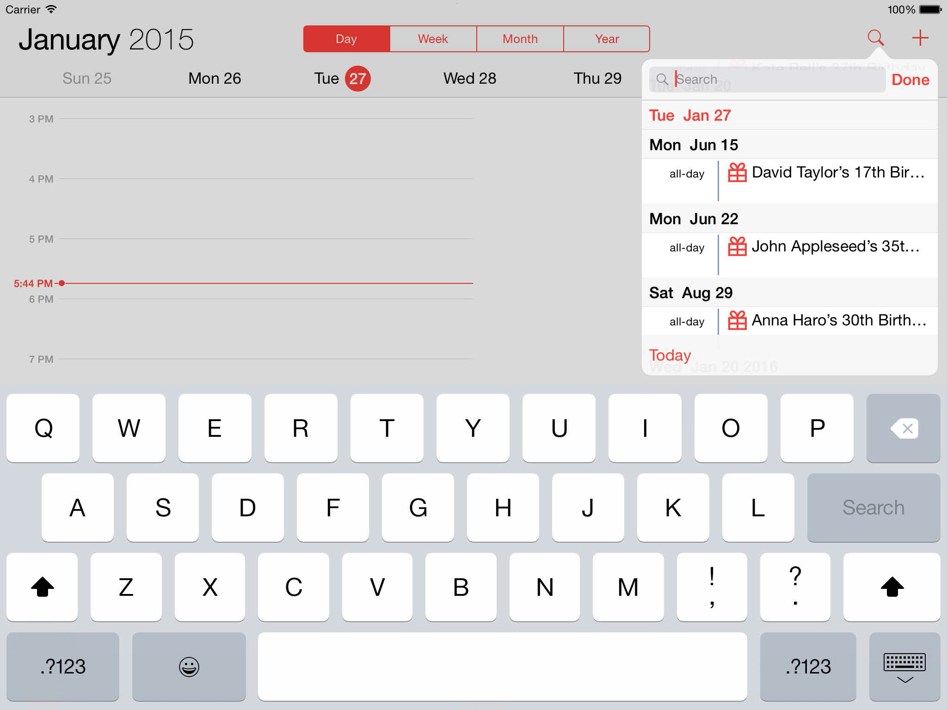
Popover
Popover在屏幕上弹出一个完整的MVC

Slide 31
Popover
Popover与其他controller不同
  不是UIViewController
但是仍然是通过segue的方式
Prepare segue时候要注意
  所有的segue都是UIPresentationController来管理的
    能够告诉你是什么导致popover出现
    还能控制Popover出现的方式

Slide 32
Popover
      func prepare(for segue: UIStoryboardSegue, sender: Any?) {
      if let identifier = segue.identifier {
      switch identifier {
      case “Do Something in a Popover Segue”:
      if let vc = segue.destinationViewController as? MyController {
      if let ppc = vc.popoverPresentationController {
      ppc.permittedArrowDirections = UIPopoverArrowDirection.Any
      ppc.delegate = self
      }
      // more preparation here
      }
      default: break
      }
      }
      }

Slide 33
Popover
通过成为PresentationController的Delegate能做什么？
  控制显示的尺寸
      func adaptivePresentationStyleForPresentationController(UIPresentationController)
      -> UIModalPresentationStyle
      {
      return UIModalPresentationStyle.None // don’t adapt (default is .FullScreen)
      }
      甚至返回一个UIViewController用于显示
      func presentationController(UIPresentationController,
      viewControllerForAdaptivePresentationStyle: UIModalPresentatinoStyle)
      -> UIViewController?
      {
      // return a UIViewController to use (e.g. wrap a Navigation Controller around your MVC)
      }

Slide 34
Popover
控制Popover的大小
  通过自身的一个属性
      var preferredContentSize: CGSize

